Slide 1


<Joshua Lacerda>
<Date: June 2023>

Slide 2

Outline
Executive Summary - 3
Introduction - 4
Methodology - 5
Results - 17
Conclusion - 45
Appendix - 46

Slide 3
Executive Summary
Summary of methodologies
Data Collection from SpaceX API and public reports
Data wrangling and analysis of potential for successful rocket landings
SQL and EDA to evaluate outcomes in relation to multiple parameters
Data Visualization in charts and dashboards to facilitate reporting and analysis.
Machine Learning to find the best model that predicts the outcome with higher accuracy
Summary of all results
Four models created to predict if SpaceX’s First Stage rocket lands successfully or not. We use Logistic Regression; Support Vector Machine; Decision Tree Classifier and K nearest neighbors.
All models predicted with similar accuracy of 83.33%. However, the Tree Classifier stands out with a 94.4% accuracy. This is a good prediction, but not ideal. Hopefully we’ll keep gathering more data and analysis to improve the accuracy rate.

Slide 4
Introduction
Project background and context
In this capstone, we will predict if the Falcon 9 first stage will land successfully. SpaceX advertises Falcon 9 rocket launches on its website with a cost of 62 million dollars; other providers cost upward of 165 million dollars each, much of the savings is because SpaceX can reuse the first stage. Therefore if we can determine if the first stage will land, we can determine the cost of a launch. This information can be used if an alternate company wants to bid against SpaceX for a rocket launch. In this lab, you will collect and make sure the data is in the correct format from an API. The following is an example of a successful and launch.
Problems you want to find answers
Be able to predict the likelihood of the first stage of a rocket landing successfully
Which parameters influence in the outcome of such success
Increase the success rate of first stage landings.

Slide 5

Section 1

Slide 6
Methodology
Executive Summary
Data collection methodology:
Combination of Data from SpaceX’s API and Web scraping
Perform data wrangling
Data transformation. Removal of irrelevant fields and entries.
Conversion of landing successes into binary format for future model prediction
Perform exploratory data analysis (EDA) using visualization and SQL
Perform interactive visual analytics using Folium and Plotly Dash
Perform predictive analysis using classification models

Slide 7
Data Collection
Describe how data sets were collected.
From the SpaceX REST API at api.spacexdata.com/v4/launches/past which is the endpoint containing the information from previous launches and landing history.
This API provides a JSON file. This file is in a dictionary format, and it makes it possible for us to use and extract pertinent information for our use.
The file is than normalized and pushed into a .csv format, which allows us to manipulate with ease.
Web scraping Wikipedia from SpaceX’s webpage and extracting the html with BeautifulSoup Python package.

Slide 8
Data Collection – SpaceX API
Present your data collection with SpaceX REST calls using key phrases and flowcharts
GitHub Link – Data Collection
API Request and response
Convert JSON file and normalize to result into a DataFrame
Create a relevant dictionary and match with a pandas DataFrame
Transform the DataFrame and analyze missing values to assure proper data structure and info
Export the data to a desired format in order to interpret and gather desired predictions.
Filter the Dataframe to contain only useful and target information

Slide 9
Data Collection - Scraping
Present your web scraping process using key phrases and flowcharts
GitHub Link – Data Scraping
Request the HTML of SpaceX’s Wikipedia web page
Parse the data using BeautifulSoup library
Search for the table containing information regarding Launches
Create a DataFrame by parsing the launch HTML tables
Export the data to a desired format in order to interpret and gather desired predictions.

Slide 10
Data Wrangling
Describe how data were processed
Understand the data and separate the successful landing to unsuccessful ones
Successful landings are converted to the value of 1
Unsuccessful landing are converted to the value of 0
You need to present your data wrangling process using key phrases and flowcharts
Separate the information as per Launch Sites by using value_count() method.
Calculate the number of occurrence of mission outcome per orbit
Create a landing outcome label from the Outcome column and classify into 1’s and 0’s
Determine the success rate overall and per Launch site
Add the GitHub URL of your completed data wrangling related notebooks, as an external reference and peer-review purpose
GitHub Link – Data Wrangling

Slide 11
EDA with Data Visualization
Summarize what charts were plotted and why you used those charts
The Exploratory Data Analysis was intended to identify how the independent variables could affect the outcome of the dependent variable, in this case, successful launches and landing.
Charts plotted
sns.catplot(y="PayloadMass", x="FlightNumber", hue="Class", data=df, aspect = 5)
sns.catplot(y="LaunchSite", x="FlightNumber", hue="Class", data=df, aspect = 5)
sns.catplot( y="PayloadMass", x="LaunchSite", hue="Class", data=df, aspect = 5)
sns.catplot(y="LaunchSite", x="PayloadMass", hue="Class", data=df, aspect = 5)
sns.barplot(y="Class", x="Orbit", data=df_orbit)
sns.catplot(y="Orbit", x="FlightNumber", hue="Class", data=df, aspect = 5)
sns.catplot(y="Orbit", x="PayloadMass", hue="Class", data=df, aspect = 5)
sns.lineplot(data = df, x="Date" , y="Success Rate")
Add the GitHub URL of your completed EDA with data visualization notebook, as an external reference and peer-review purpose
GitHub Link – EDA with Data Visualization

Slide 12
EDA with SQL
SQL Queries performed
Display the names of the unique launch sites in the space mission
Display 5 records where launch sites begin with the string 'CCA'
Display the total payload mass carried by boosters launched by NASA (CRS)
Display average payload mass carried by booster version F9 v1.1
List the date when the first succesful landing outcome in ground pad was acheived.
List the names of the boosters which have success in drone ship and have payload mass greater than 4000 but less than 6000
List the total number of successful and failure mission outcomes
List the names of the booster_versions which have carried the maximum payload mass. Use a subquery
List the records which will display the month names, failure landing_outcomes in drone ship ,booster versions, launch_site for the months in year 2015.
Rank the count of successful landing_outcomes between the date 04-06-2010 and 20-03-2017 in descending order.
Add the GitHub URL of your completed EDA with SQL notebook, as an external reference and peer-review purpose
GitHub Link – EDA with SQL

Slide 13
Build an Interactive Map with Folium
Multiple Maps were created with the Folium package.
This package allows us to plot maps of many kinds and complexities. Making maps interactive and meaningful.
Plotting a map may not mean much without a proper description and legends. And in order to present meaning and insights to a map, there are different tools from which we can select.
Markers and circles were used to better display the information in our DataFrame and to facilitate the interpretation of the data presented.
Add the GitHub URL of your completed interactive map with Folium map, as an external reference and peer-review purpose
GitHub Link – Interactive map with Folium

Slide 14
Build a Dashboard with Plotly Dash
A dashboard was created using Plotly Dash Application. And in the application we generated two interactive charts. One Pie Chart and a second Scatter Plot chart
The Pie Chart contains information of the success rate of Launches and landings for each site.
The Scatter plot shows us the success of these Launches and Landings in relation to the Payload Mass (in kg) that the rocket carried
The idea of an interactive dashboard is such that you can visually analyze the data you’re working with and make decisions faster.
Add the GitHub URL of your completed Plotly Dash lab, as an external reference and peer-review purpose
GitHub Link – Dash_Interactivity

Slide 15
Predictive Analysis (Classification)
Split the Column Class from the dataset
Fit and Transform using StandardScaler() method
Use train_test_split to split the data into training set and test set
Use the training data to fit models as per each predictive analysis model
Plot a Confusion Matrix for each model tested
Use GridSearch() on LogReg, KNN, SVM, DecisionTree Models
Use the test data on each model to determine accuracy
With a Bar chart plot, evaluate and compare score of models
Add the GitHub URL of your completed predictive analysis lab, as an external reference and peer-review purpose
GitHub Link – Predictive Analysis

Slide 16
Results
Exploratory data analysis results
Interactive analytics demo in screenshots
Predictive analysis results

Slide 17

Section 2

Slide 18
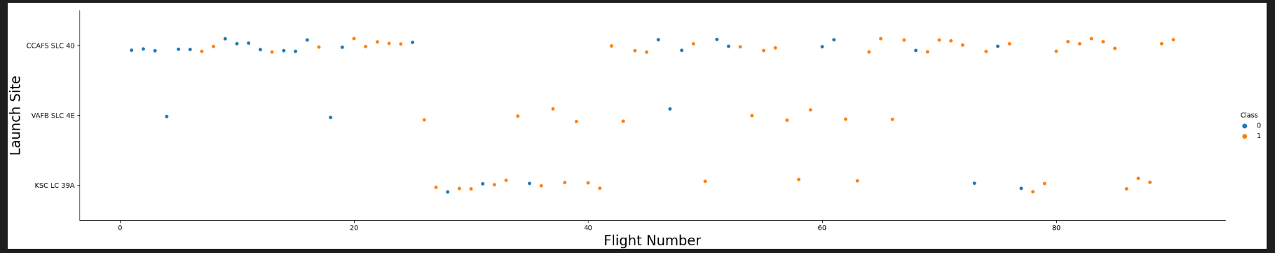
Flight Number vs. Launch Site
Show a scatter plot of Flight Number vs. Launch Site
We compare the flight number and launch site locations and evaluate the success (Class 1) and failures (Class 0) for each mission. The result shows good amount of success from different location, but it is important to highlight that the number of failures are decreasing substantially as the flights numbers increase. Showing a successful progress by each launch.

Slide 19
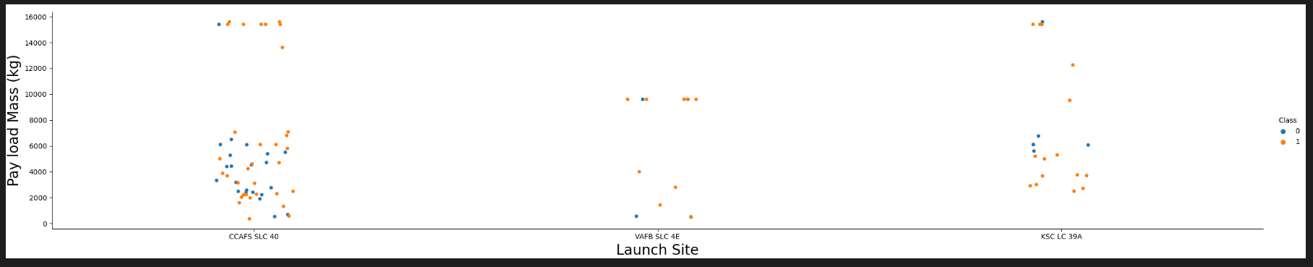
Payload vs. Launch Site
Show a scatter plot of Payload vs. Launch Site
Different launch sites present different limitations, successes and failures. As shown, the VAFB site present a limitation of 10000kg of capacity as per CCAFS and KSC sites can launch rockets as heavy as 16000kg.
We can also observe that the CCAFS launch site is one of the most used out of all launch sites.

Slide 20
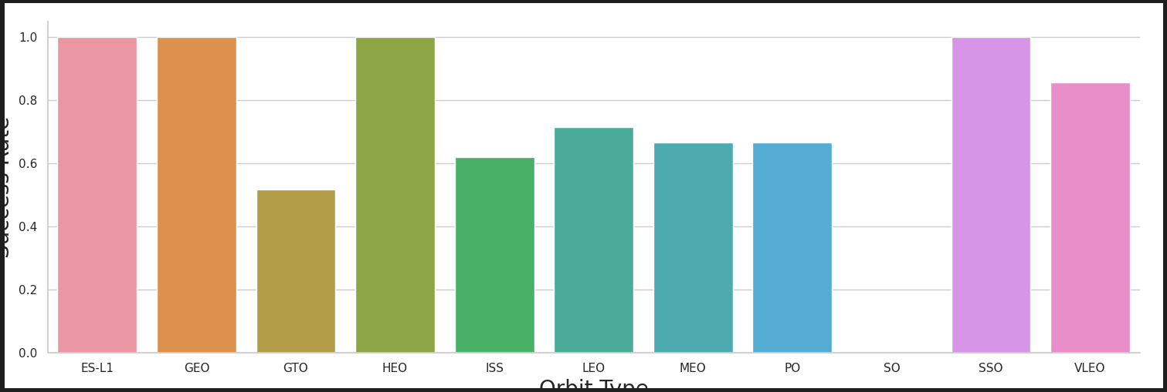
Success Rate vs. Orbit Type
Show a bar chart for the success rate of each orbit type
The success rate of the Orbits ES-L1, GEO, HEO and SSO are 100% successful. As for the SO orbit has never had a successful launch.
The information on this bar chart is missing the number of launches per site, for us to determine how efficient a launch site is or can be.

Slide 21
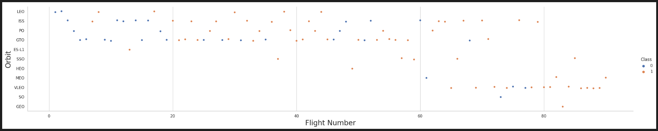
Flight Number vs. Orbit Type
Show a scatter point of Flight number vs. Orbit type
In this chart we can have better understanding of how Orbits can influence if the launch is successful or not.
We observe that SpaceX started with different Orbits and the success rate was fluctuating. In recent launches, the Sun Synchronous Orbit has been the preference and success has improved.

Slide 22
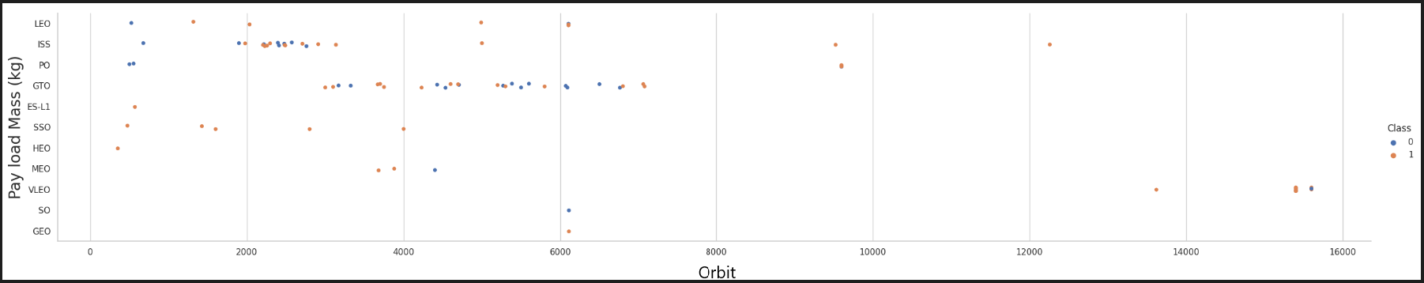
Payload vs. Orbit Type
Show a scatter point of payload vs. orbit type
There isn’t much of a significant correlation between Payload and Orbit.
We can see that majority of flights are in the GTO (Geosynchronous orbit), which is a very important orbit that monitors many factors of our daily lives such as communication, weather, surveillance, etc

Slide 23
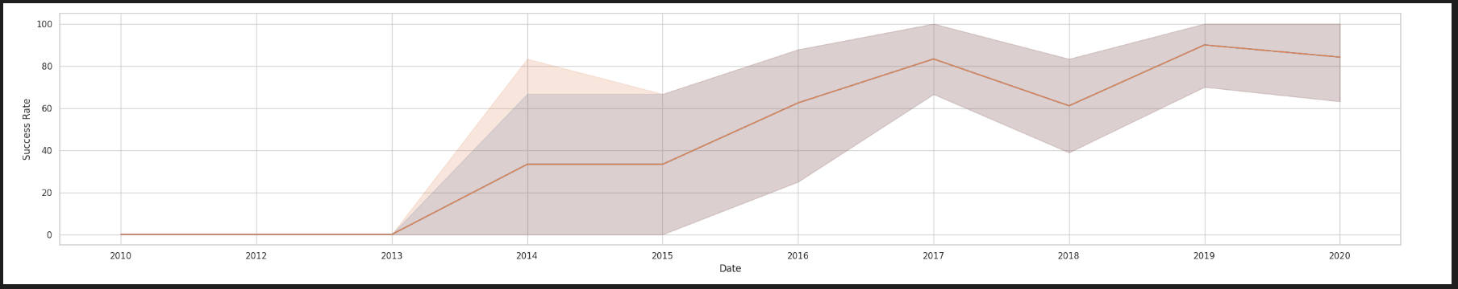
Launch Success Yearly Trend
Show a line chart of yearly average success rate
The line chart shows the successful rates along the years. And as we can see the trend after 2013, we show that successful launches are occurring more often, which shows that the effort to make the missions safer, is paying off and we hope to see this trend line reach 100% success rate in the years to come.

Slide 24
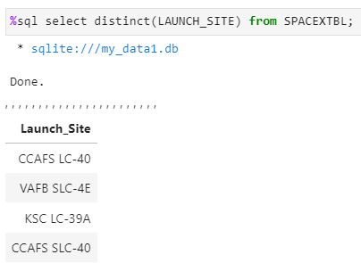
All Launch Site Names
Find the names of the unique launch sites
The query returns the unique launch site names.
We do see CCAFS as SLC-40 and LC-40, which represent the same location, but it seems that the data has wrong data entry, generating this error.

Slide 25
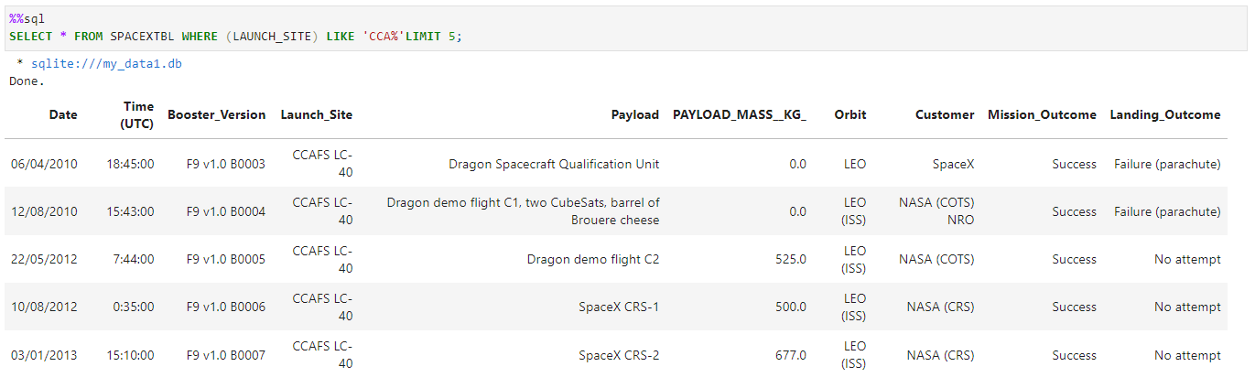
Launch Site Names Begin with 'CCA'
Find 5 records where launch sites begin with `CCA`
Display the first five entries where the launch site name starts ‘CCA’

Slide 26
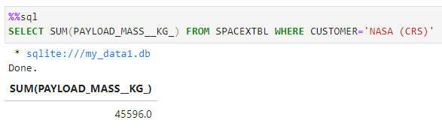
Total Payload Mass
Calculate the total payload carried by boosters from NASA
The value displayed value represents the total payload sent to space where the customer was NASA.
The information also refers to CRS (Commercial Resupply Services), that indicates that these mission were carrying payloads to the ISS.

Slide 27
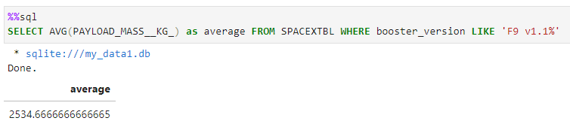
Average Payload Mass by F9 v1.1
Calculate the average payload mass carried by booster version F9 v1.1
An average of how much payload the booster Falcon9 v1 carried on its missions.

Slide 28
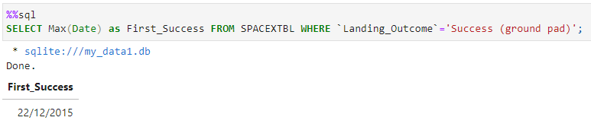
First Successful Ground Landing Date
Find the dates of the first successful landing outcome on ground pad
The date where the first successful launch and landing at a ‘ground pad’ occurred in December 22 of 2015. Which is a very good Christmas gift for all the work done.

Slide 29
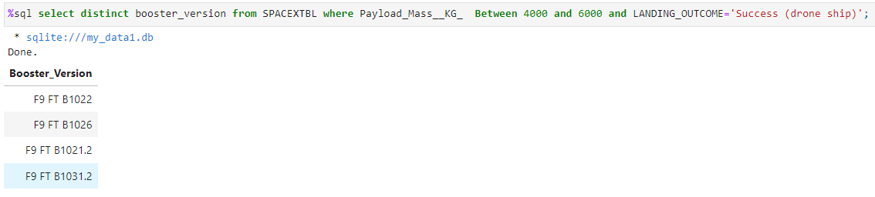
Successful Drone Ship Landing with Payload between 4000 and 6000
List the names of boosters which have successfully landed on drone ship and had payload mass greater than 4000 but less than 6000
The four booster versions were successfully landed at a drone ship and their payloads were bigger than 4000kg and not greater than 6000kg.

Slide 30
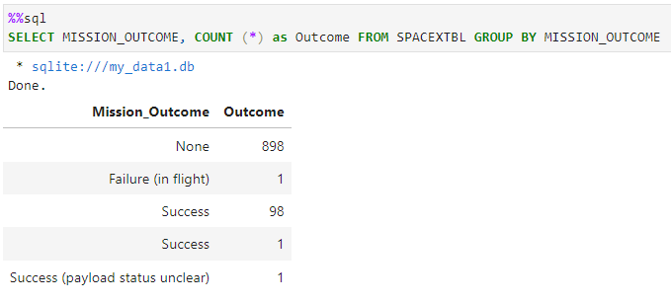
Total Number of Successful and Failure Mission Outcomes
Calculate the total number of successful and failure mission outcomes
There are many data entries with no information. The correct action to display this, was to first clean all the null entries.
The query shows us the mission outcome, which points us to an amazing 99% successful outcome.

Slide 31
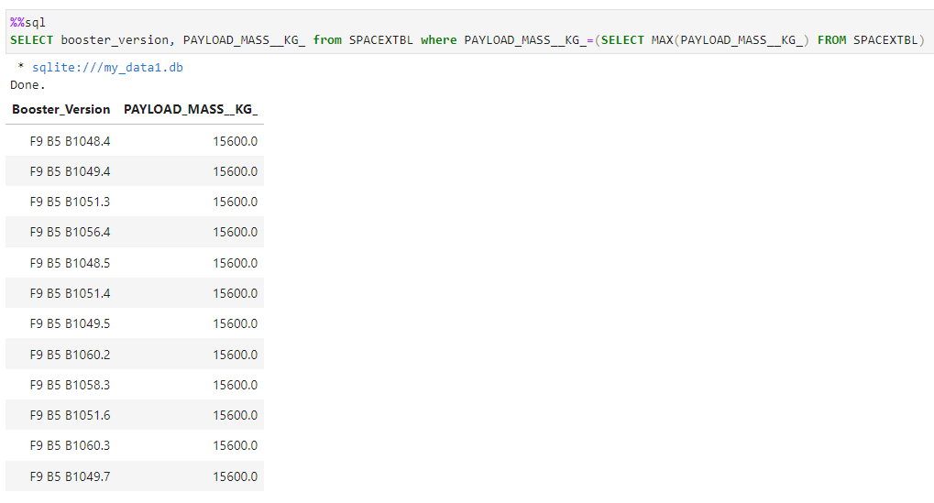
Boosters Carried Maximum Payload
List the names of the booster which have carried the maximum payload mass
All the boosters displayed above, have carried the maximum payload in their missions.

Slide 32
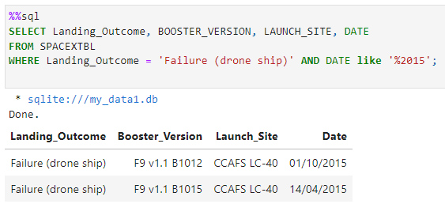
2015 Launch Records
List the failed landing_outcomes in drone ship, their booster versions, and launch site names for in year 2015
The query displays the two failed launches that attempted to land on the drone ship

Slide 33
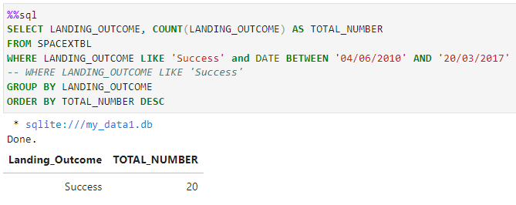
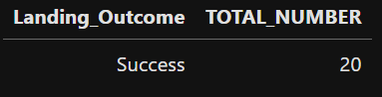
Rank Landing Outcomes Between 2010-06-04 and 2017-03-20
Rank the count of landing outcomes (such as Failure (drone ship) or Success (ground pad)) between the date 2010-06-04 and 2017-03-20, in descending order
Present your query result with a short explanation here

Slide 34

Section 3

Slide 35
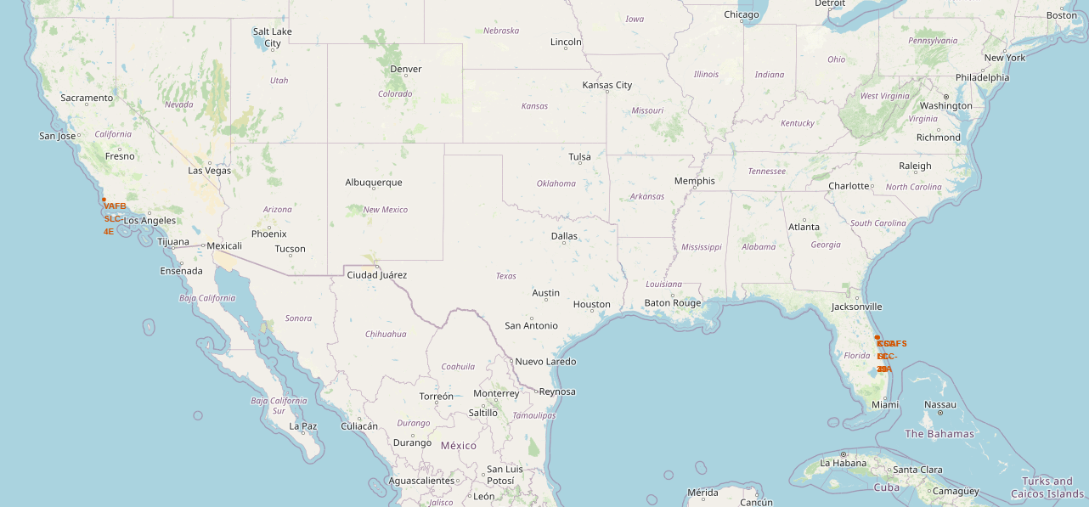
Folium Map: All launch sites
We observer that the launch sites are located in the USA, however with some similarities, which they all are near the coast, and also in the south of the country, which brings the launches closer to the equator.

Slide 36
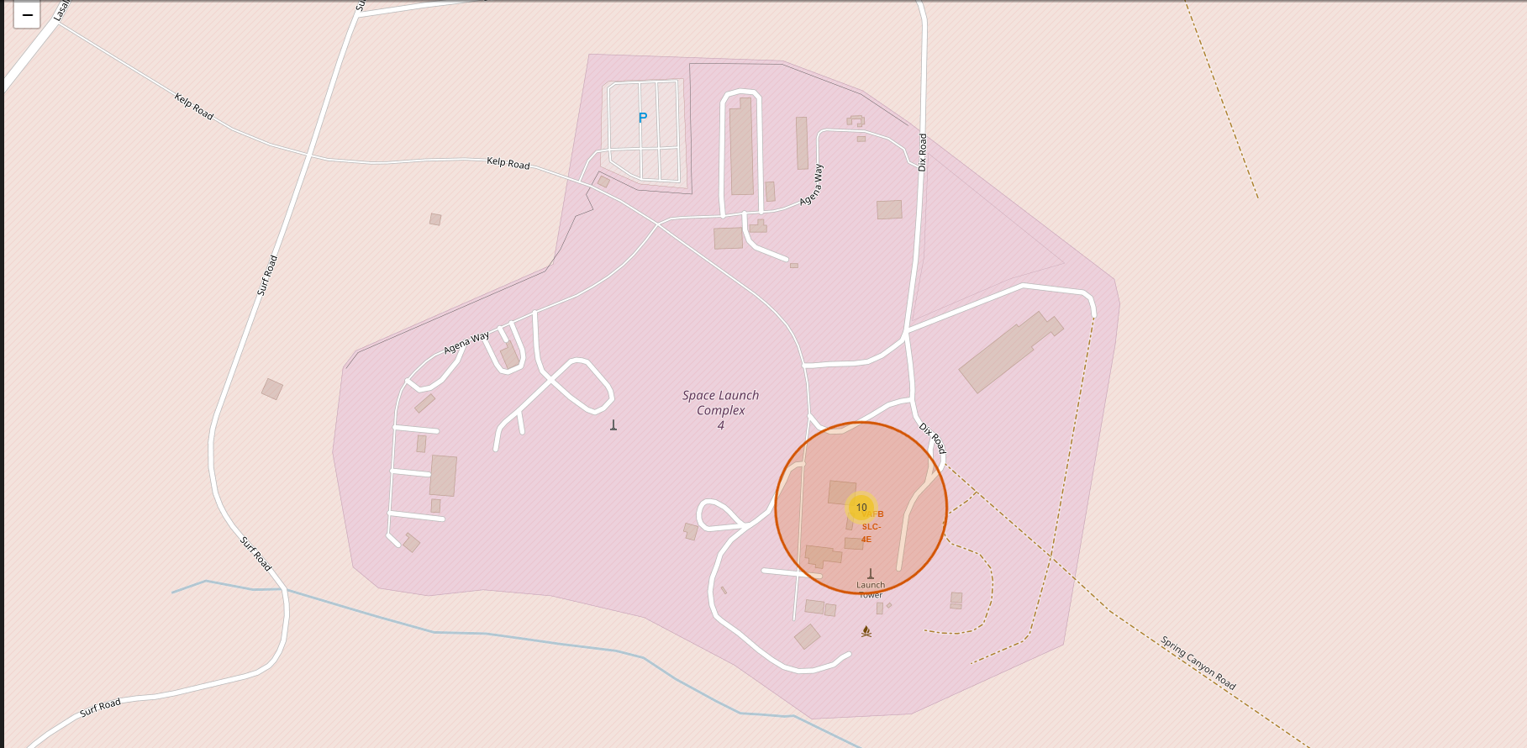
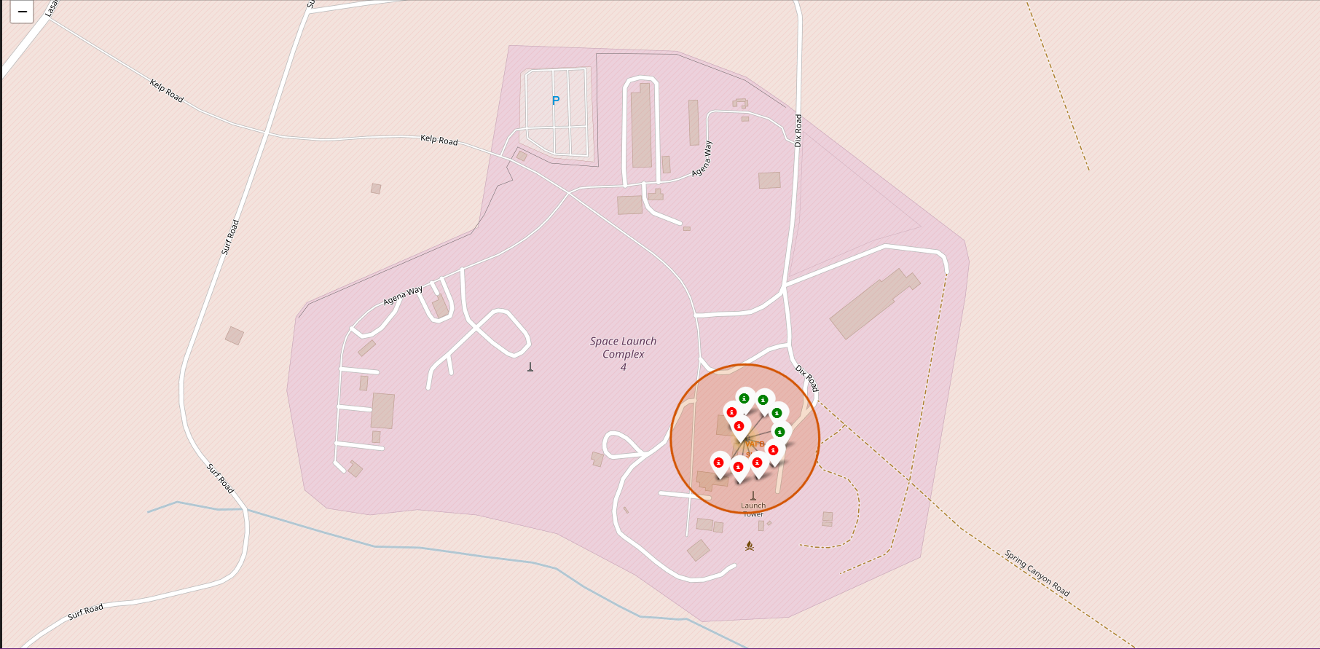
Folium Map: Color Launch Markers
Both images display the same region of the map.
The left side, you can observe the number 10 inside the marker. Which shows us that there were 10 launches from this site.
The right-hand side, we see as colored markers how these launches and landing took place. Green shows us the successful complete mission, as for red the incomplete one.

Slide 37
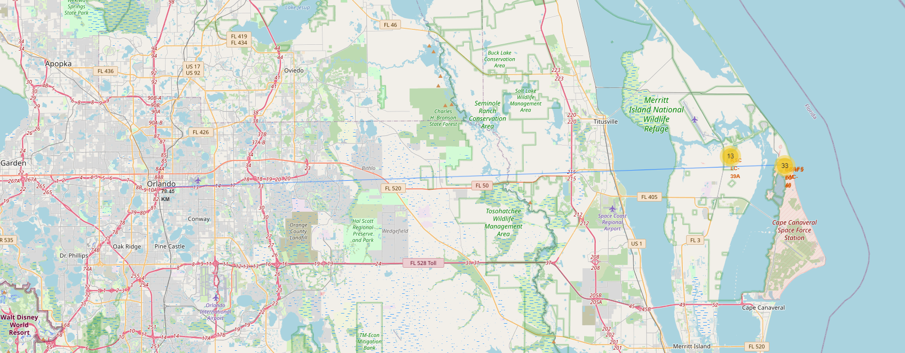
<Folium Map Screenshot 3>
This is to show the distance from the launch sites located in the coast of Florida to the city of Orlando, which is one of the biggest in the state.
The distance in a straight line is of 78.45 km. which shows us that the space mission launches are cautiously planned, in order to ensure safety of cities nearby.

Slide 38

Section 4

Slide 39
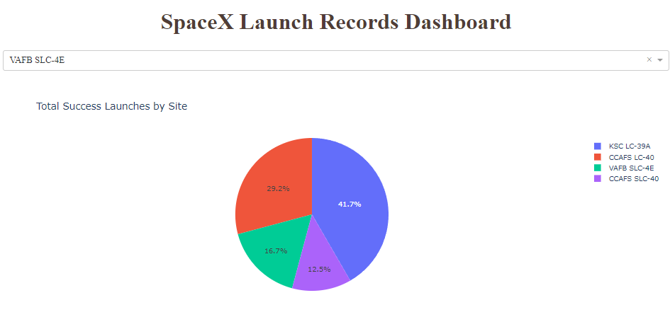
Pie Chart – Plotly Dash – Success Rate by Launch Site
The chart shows us the success rate of each launch site. And we can observe that KSC has the highest success, and the lowest rate is the CCAFS location.

Slide 40
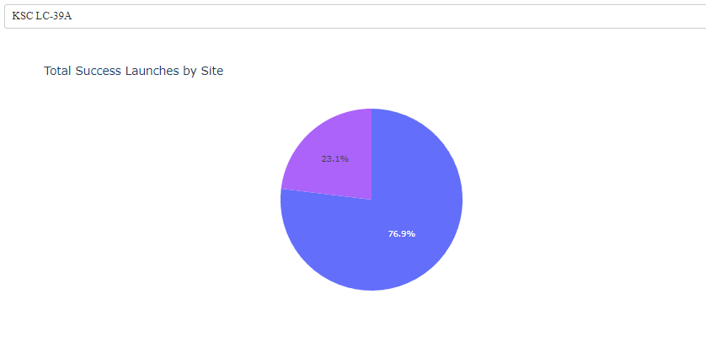
Pie Chart – Plotly Dash – Success rate for KSC LC-39A
The pie chart highlights the success rate of the most successful launch site of all.
We can see that 76.9% of all missions are concluded as planned. As for the remaining 23.1% are all case to study for future improvements.

Slide 41
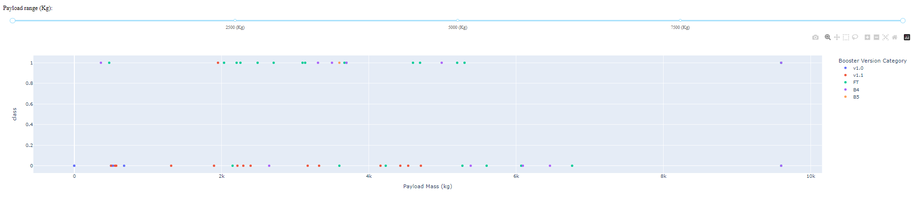
<Dashboard Screenshot 3>
The Scatter plot has the success and failure of launches in relation to the payload mass and it has the legend to show us the different versions of boosters used in the missions.
The Scatter plot done in the Plotly Dash dashboard, provides us with a range selector slider, from which we can choose the payload mass of the missions displayed. Unfortunately, it only shows us up to 10000kg, and as we know, the payload goes all the way up to 15600kg.
The data also shows 0kg payload mass launches that failed. This could be a data entry error. Further analysis would be ideal.

Slide 42

Section 5

Slide 43
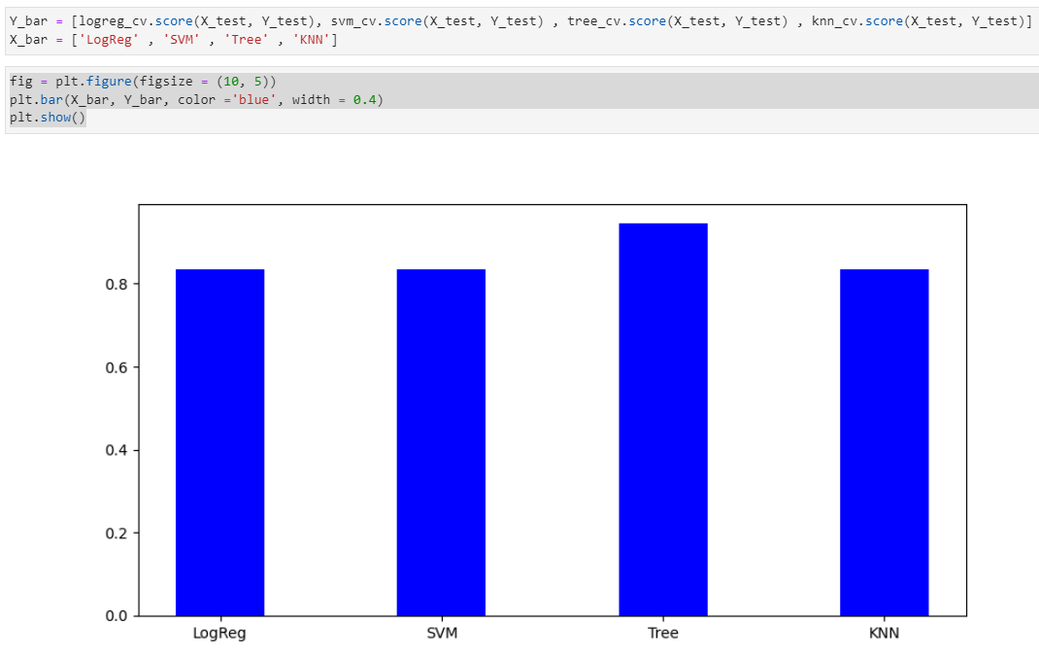
Classification Accuracy
Visualize the built model accuracy for all built classification models, in a bar chart
As shown, we see that three model predictions have the same accuracy (83.33%) and the Classifier Tree model stands out with a 94.4% accuracy.
One factor for this interesting result, may be that we don’t have sufficient data to have more training sets and test them for a better prediction.

Slide 44
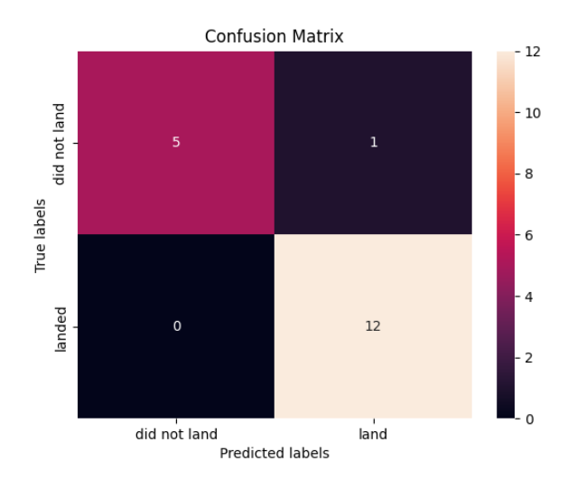
Confusion Matrix
Show the confusion matrix of the best performing model
Since all predictive models performed the same, all their confusion matrices are the same.
The models predicted 12 successful landings when the true label was successful
The models predicted 5 unsuccessful landings when the true label was unsuccessful landing
The models predicted 1 success landings when the true label was unsuccessful landings (false positives)
The model over predicted successful landings.

Slide 45
Conclusions
In this study, our goal was to develop a predictive model, using machine learning and predictive analysis, to determine if the first stage of rockets will be reused or not.
The determination of this subject, it allows company such as SpaceX to charge about 100 millions less from its competitors.
The results we got from our predictions, generated the same results, even though we used four different models. The reason behind this is the amount of data we have available.
The accuracy of most of our prediction models are of 83.33%. The Tree classifier stands out at a 94.4% Accuracy. A good result, however, we want to be at 100% when we are dealing with rocket launches.
In order to improve our models and achieve the goal of 100% accuracy, we will need to continue collecting data and make sure that all proper dependent variables are in consideration, so that our independent variable (the successful launch and land) can be predicted safely.
I’m positive that time and data will take us to our goals.

Slide 46
Appendix
Include any relevant assets like Python code snippets, SQL queries, charts, Notebook outputs, or data sets that you may have created during this project
https://github.com/joshuabls/Applied-Data-Sciece-Capstone
https://cf-courses-data.s3.us.cloud-object-storage.appdomain.cloud/IBM-DS0321EN-SkillsNetwork/labs/module_2/data/Spacex.csv
https://api.spacexdata.com/v4/launches/past
https://en.wikipedia.org/wiki/List_of_Falcon_9_and_Falcon_Heavy_launches

Slide 47


